Slide 1
Nature and Nurture

Slide 2
The Big Questions
How is evolution even possible, and what are genes, alleles, heritability, etc?
How much of our behavior is genetic, and how much is environmental?

Slide 3
Humans developed from earlier species of animals
A. True
B. Not Sure
C. False

Slide 4
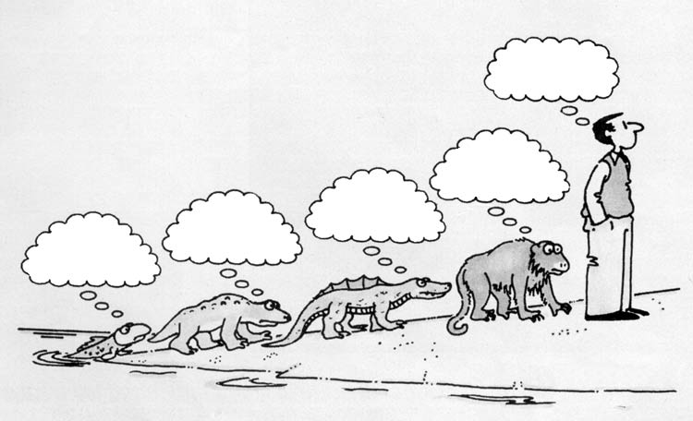
Evolution?
How does a fish EVER give birth to something other than a fish!?

Slide 5
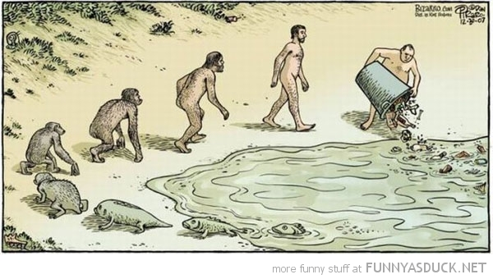
☺

Slide 6
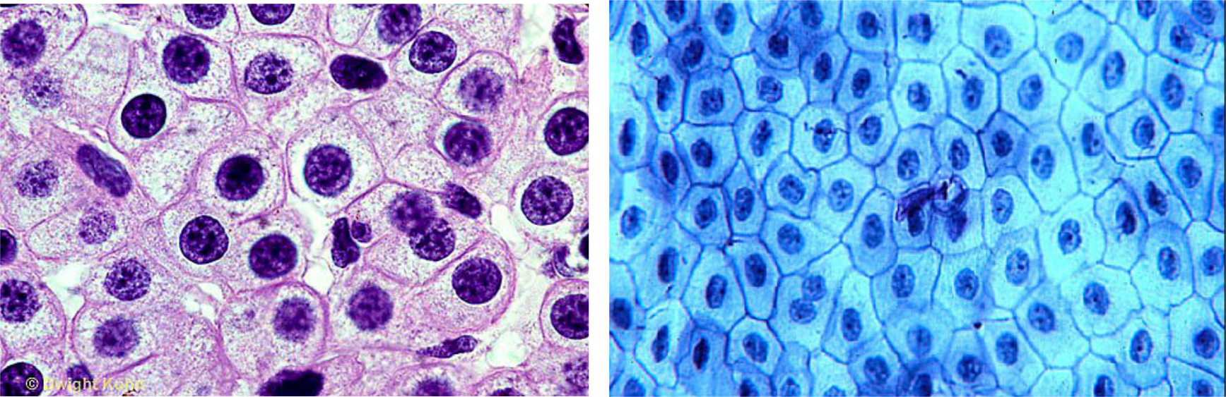
Hard to Fathom
It took a long time (longer than you can imagine!)
- very, very gradual change..
We don’t think of ourselves as cells (which is frog, human?):
Notes:
?

Slide 7
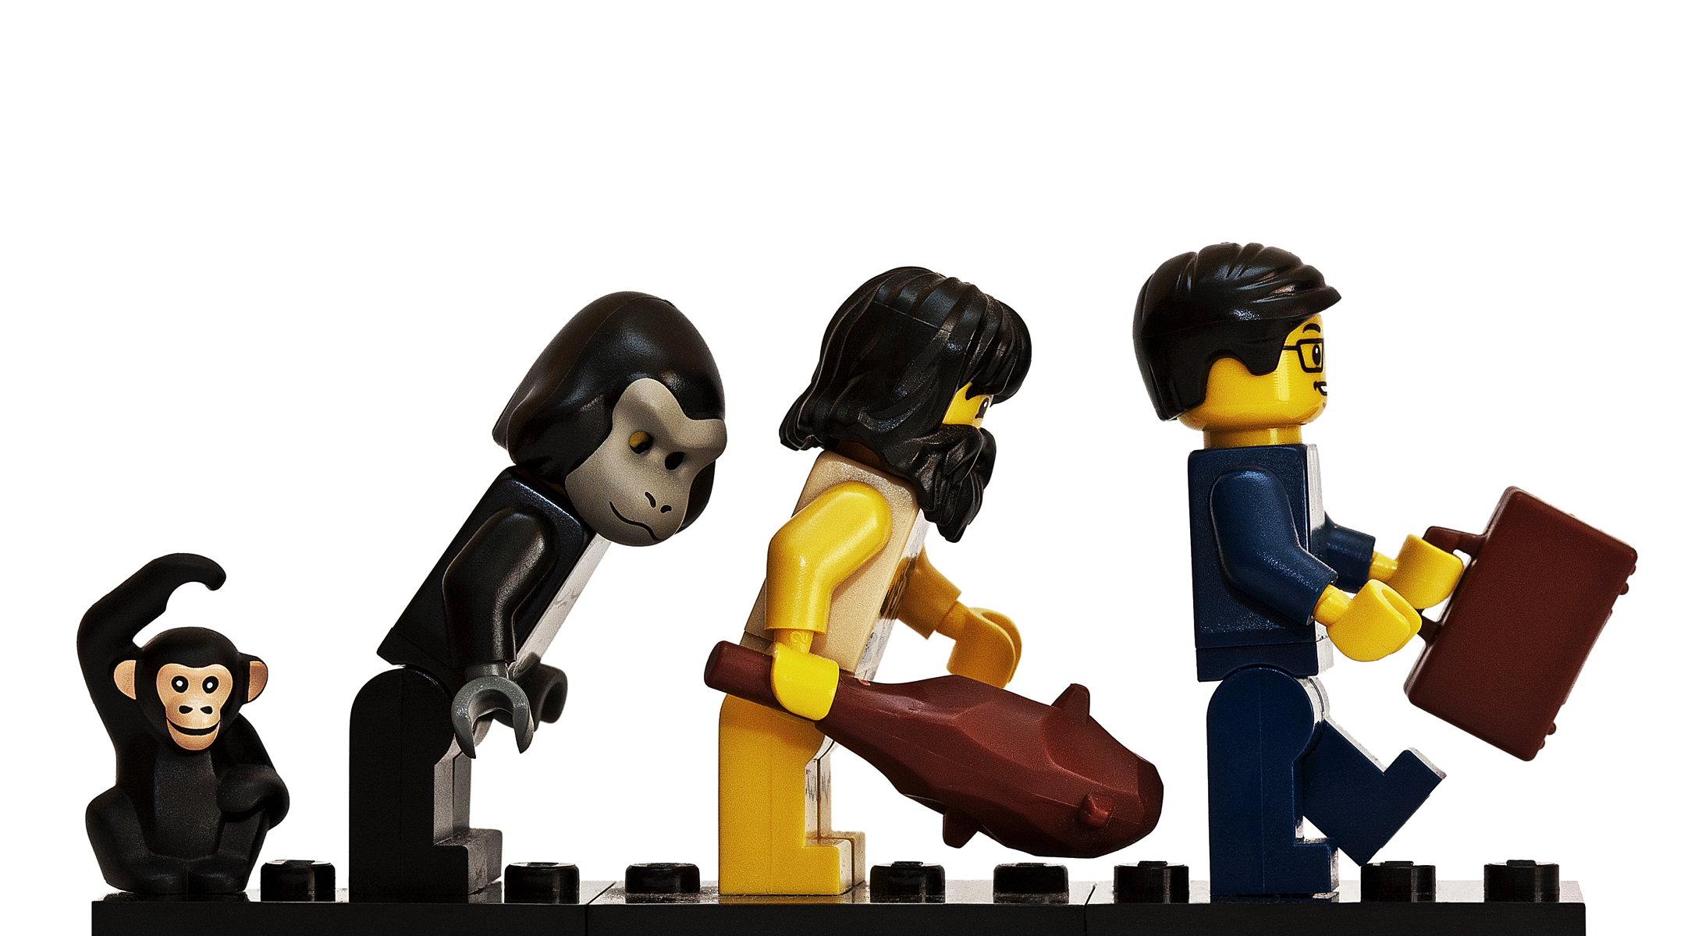
Evolution and Lego

Slide 8
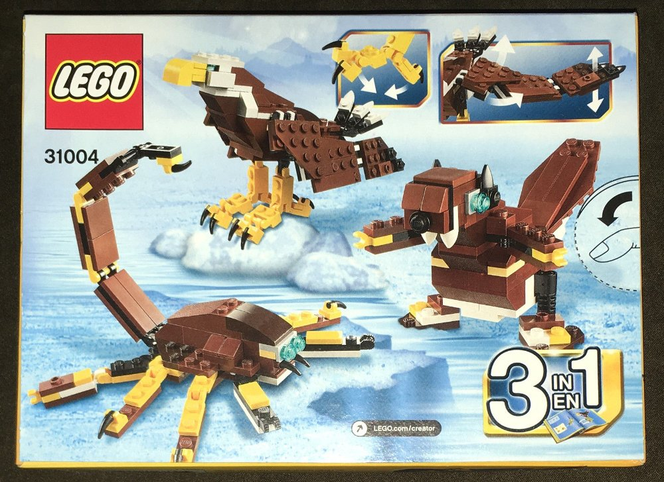
The same parts, reconfigured..
Evolution operates on an elaborate “instruction booklet” for constructing bodies from basic building blocks – the instruction book is subject to random and powerful hacking..

Slide 9
Fast Forward..
https://www.youtube.com/watch?v=z9ptOeByLA4
(soft robots evolving before your eyes..)

Slide 10
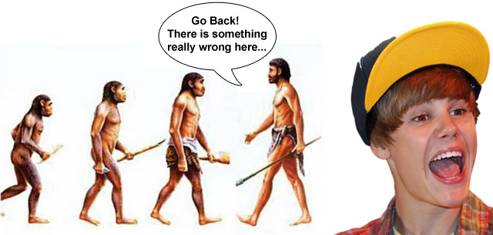

Slide 11
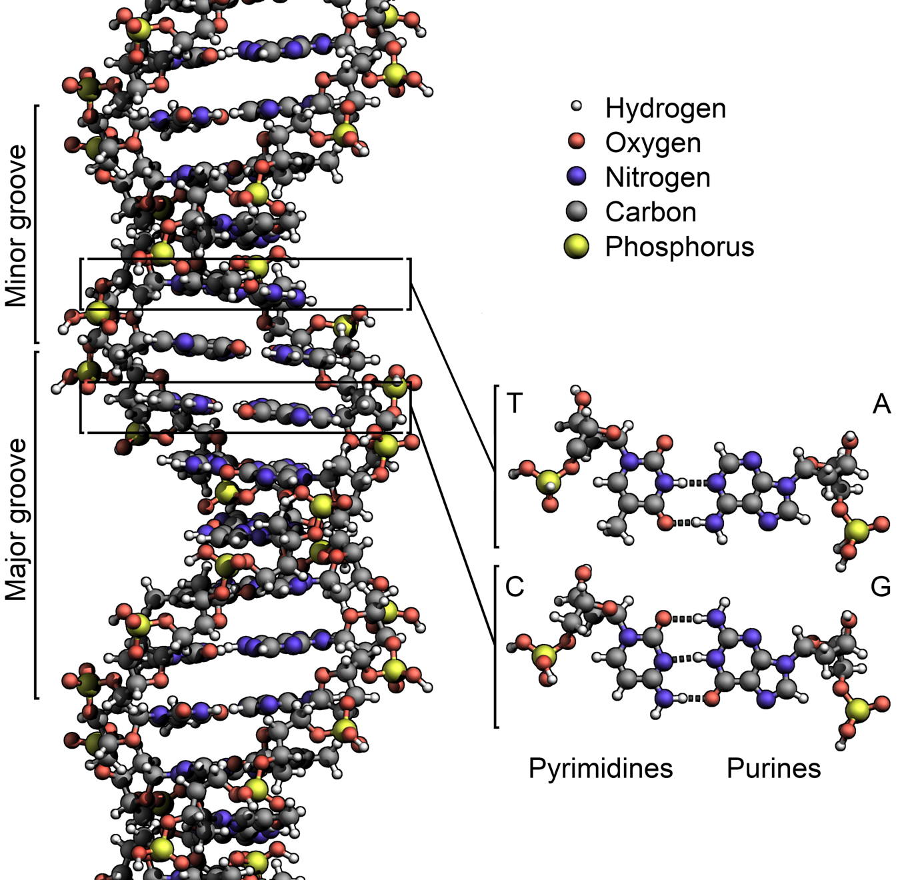
The Instructions
Genes = Lego instruction pages
Base pair (G,C,T,A: Gattaca, nucleotide) 3 = one Lego brick (amino acid)
Gene = Protein = sequence of amino acids (~300 = ~900 bp’s, but genes ~27,000 bp)
Alleles = different instructions for different folks – different gene variants

Slide 12
The Instructions
Genes = Lego instruction pages
Only 1.5% of human DNA codes for proteins, ~20,000 proteins in all (like most animals)
Between 20-85% of DNA may be “junk”
Rest is regulatory / control: if, then, else, for, while, etc of the genetic program!

Slide 13
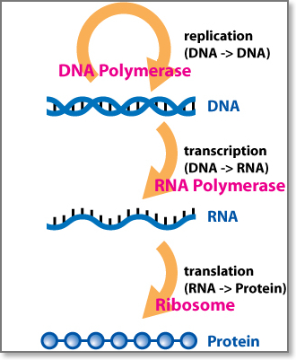
RNA and DNA
DNA makes RNA (Transcription)
RNA makes proteins
(Translation)
Proteins make us

Slide 14
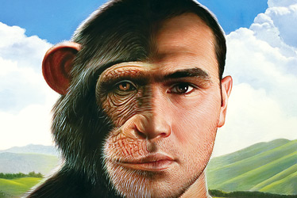
98.8% Human?
Proteins largely the same, but regulatory / junk areas differ by ~5%

Slide 15
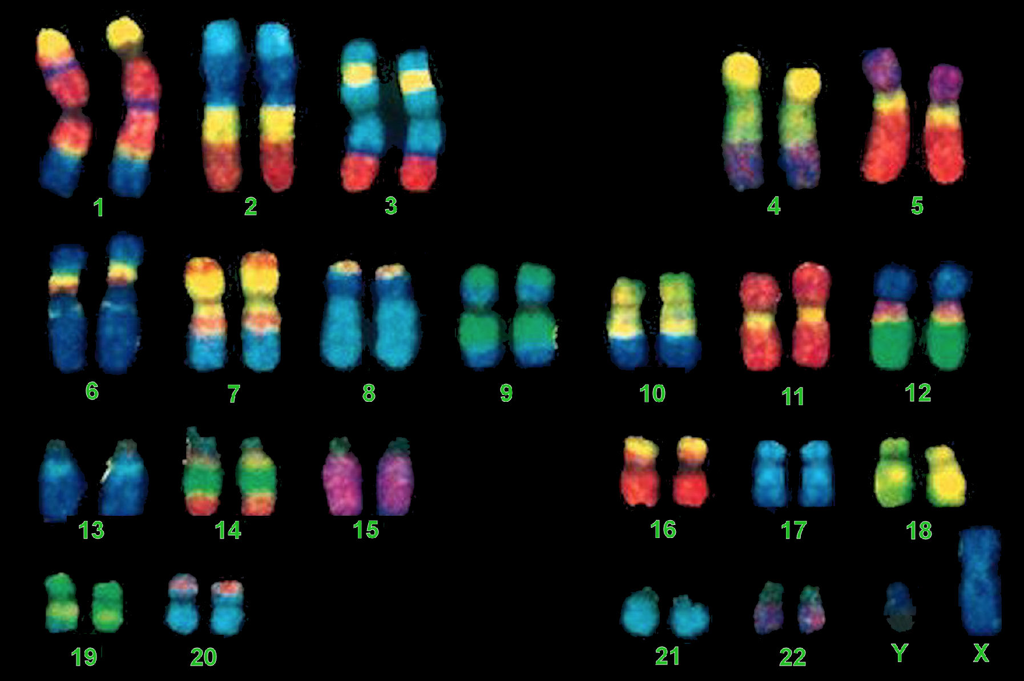
Chromosomes etc
2x of everything: mom + dad = 2
Dominant vs. recessive:
DD, Dr, rD, rr =
¾ dominant, ¼ rec.
All the bad stuff is recessive: why incest is risky!
Notes:
Chromosomes: in the nucleus of a cell, made up of DNA
Dominant gene controls phenotype, recessive gene does not

Slide 16
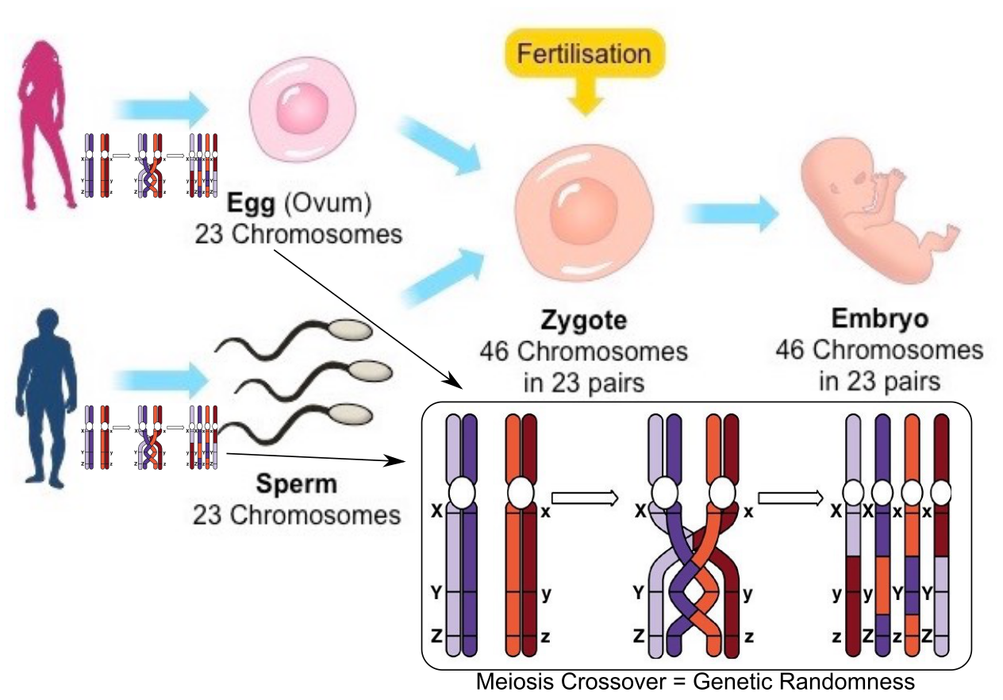
Sex = Genetic Randomness

Slide 17
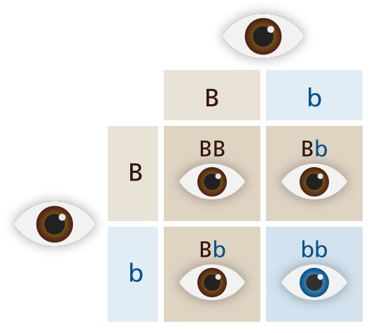
Dominant vs Recessive Logic

Slide 18
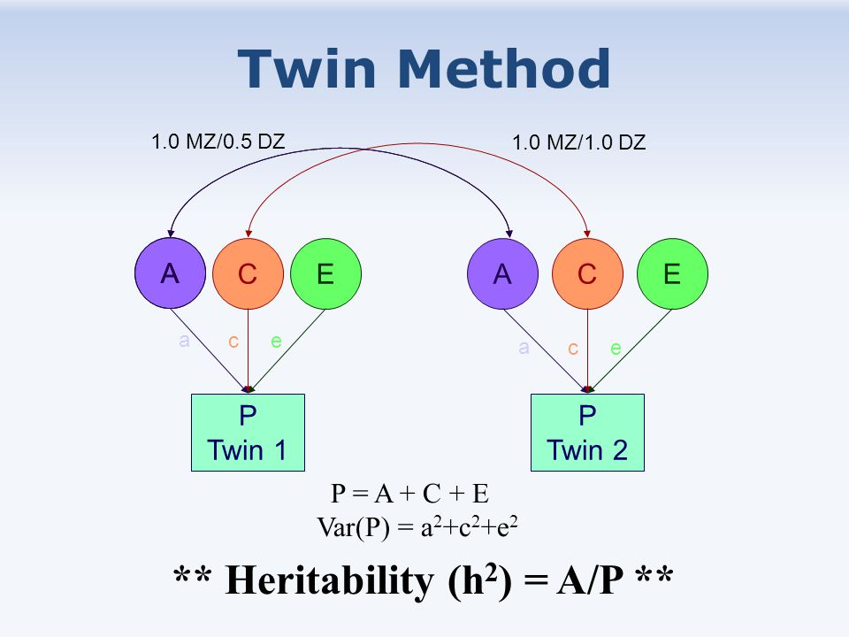
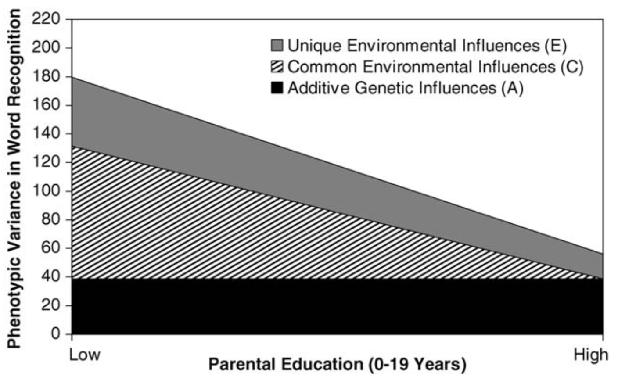
Heritability is tug-of-war between genetic and environmental factors
If environmental influences go down, measured amount of genetic heritability goes up even if the actual genetic influence remains exactly the same!!!

Slide 19
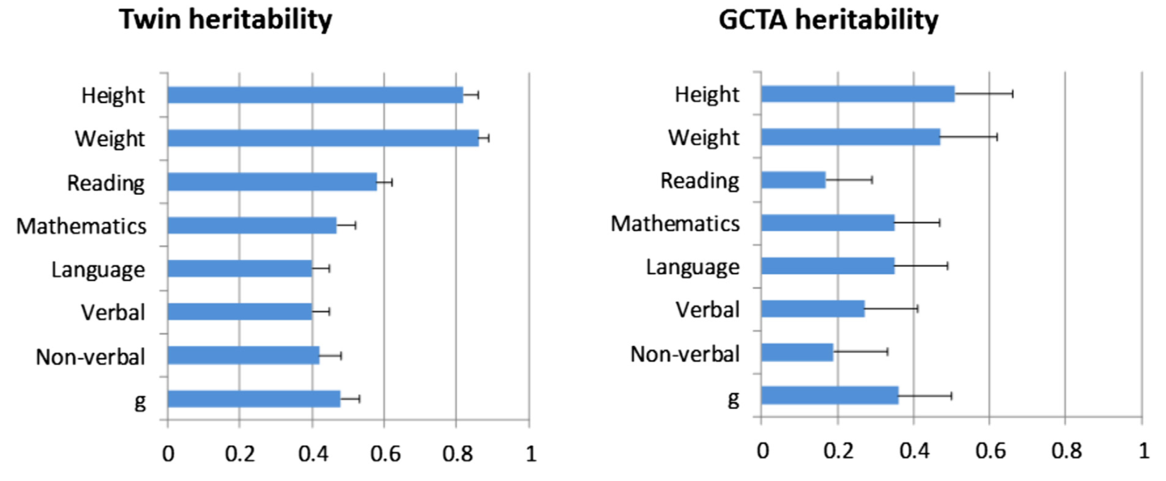
Heritability
h² = proportion of variance explained by genetics
Twin studies = 2x direct genetic contributions – missing heritability problem: rare variants
Notes:
Why do you think variables like personality and social attitudes seem to be less heritable than these different disorders?

Slide 20
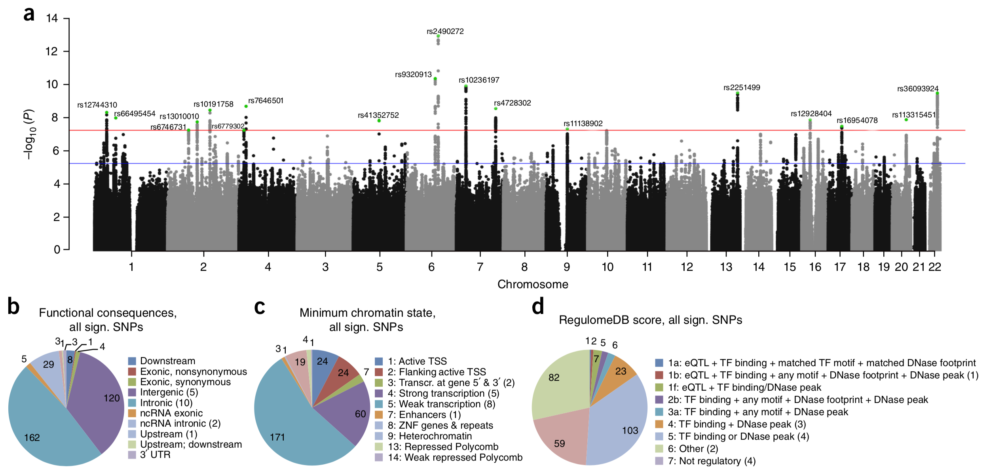
Genes and IQ
Genome-Wide Association Study (GWAS) for IQ: No single gene explains much, but if you put them all together, ~20% heritability.
IQ = Phenotype: observable characteristics or traits

Slide 21
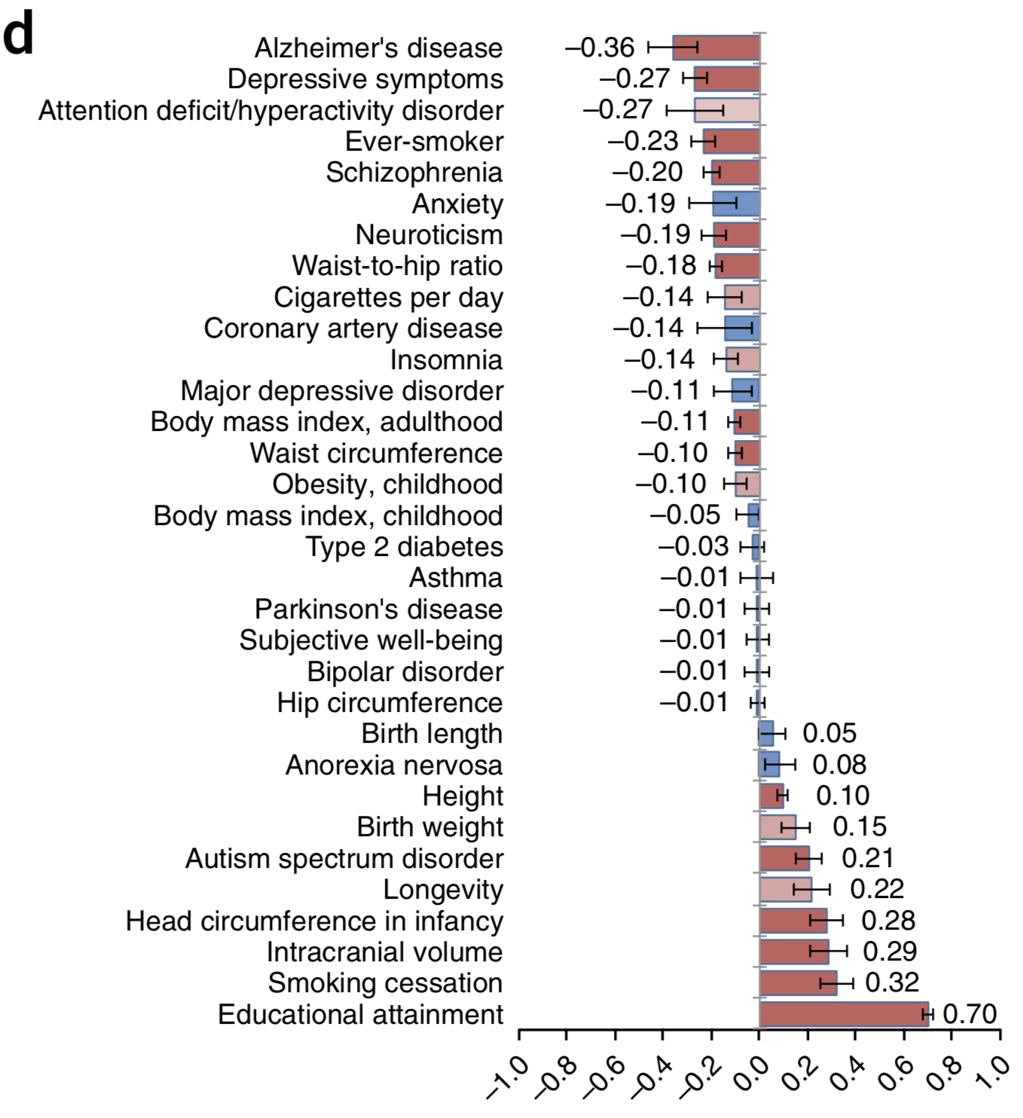
IQ Gene Associations

Slide 22
Behavioral Genetics is Big at CU
http://www.colorado.edu/ibg/home
The Colorado Adoption Project
The Colorado Twin Registry
The Colorado Learning Disabilities Research Center
Twin study: compare monozygotic twins which share 100% of DNA, with dizygotic/fraternal twins that share 50% of DNA
Allows them to estimate genetic basis of traits, as well as shared & unique environmental contributions

Slide 23
Were you a “geek” or a “nerd” in High School?
A. Yes
B. No
C. Define “geek” / “nerd”..?

Slide 24
For the geeks / nerds
Was this part of your “identity”, causing you to seek out other like-minded individuals, and pursue corresponding activities?
A. Yes
B. No
C. Define “activities”..

Slide 25
Gene / Environment Correlations
Overestimate heritability because genes influence environments!
Geeks seeking geeks do geeky things together which makes them even geekier, and thus more likely to rule the world!
And, yes, non-geeks shunning said geeks, further reinforcing said geekiness (reactive vs. active).

Slide 26
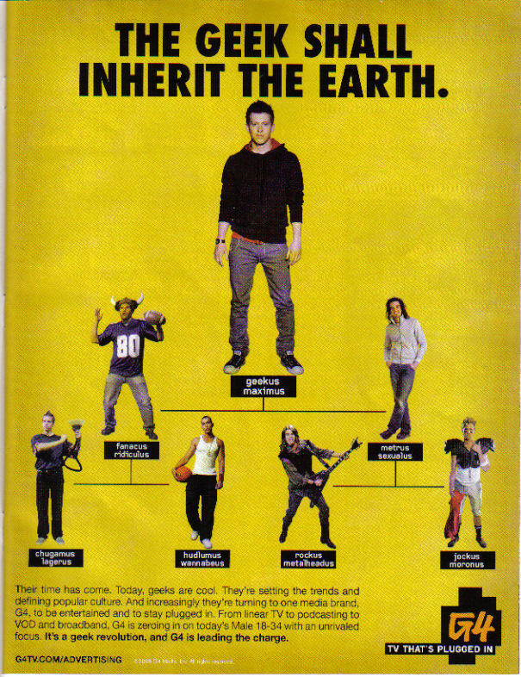


Slide 27
Everything is a Nature/Nurture Interaction
Can’t be smart if you can’t eat.
Deprivation of the basics leads to developmental problems no matter what genes you have
Parents give you genes and, for most, your early environment (c.f., twins reared apart!)
Brain is highly plastic (adaptive): h² of IQ gets larger over time: it’s about learning!

Slide 28
Evolutionary Psychology
Let me tell you a story about this caveman friend of mine..
Principles of evolutionary biology applied to human behavior: traits are evolutionary adaptations
If you weren’t there, you don’t know what the real evolutionary forces were!
(mostly “just so” stories / b.s.)
Except really obvious things, like sex, violence (raping, pillaging: whose idea was that!?)
Chimpanzees show same in-group / out-group behaviors as people..
Notes:
Example: Infanticide- explained with evolutionary psychology- By stepfathers- not spending resources on children not related to reproductive success, children with low chance of success reduce mother’s genetic fitness, given the resources she spends on raising the child

Slide 29
Nature Nurture Summary
Genes: made from DNA, determine how body develops (the program)
Genotype = all genes; Alleles = different versions of gene
Phenotype: measurable traits (IQ, ADHD..)
Behavior(al) genetics: study of genetic vs. environment influence on behavior, etc
Identical vs. fraternal twins vs. unrelated siblings
Heritability (h²): amount of variance between people that is due to genes (0..1) (low variance = more h²)
Almost everything has some heritability.. often ~.5

Slide 30
Nature Nurture Summary
Environment: (shared = family, vs. unique) – everything outside of genes that affects you..
Everything (genes, environment) typically has an effect on everything.. e.g., IQ = 50/50
Gene / Environment Correlation: environment affected by genes.. (geeks!)
Gene / Environment Interaction: different people respond differently to same environment

Slide 31
Evolutionary Psychology Summary
Adaptations: changes to solve specific problems in the (old, evolutionary) environment
Environmental mismatch: fat & sugar used to be good for you.. ☺
Sexual behavior, gender differences may be stronger targets for adaptations (double standards, etc)

